Slide 1
Hero or Heroin Revisited
By: Greg Eastman

Slide 2
Research Question
Does legalizing cannabis decrease the proportion of people admitted to rehabilitation facilities?
Medical research has found that marijuana could be a successful drug to wean people off opioids but not other drugs.
The proportion of people going to rehab for opioid addiction should theoretically be correlated with the actual rate of addiction.
Many states are legalizing and since the opioid epidemic is growing still, it is important to know policy implications.

Slide 3
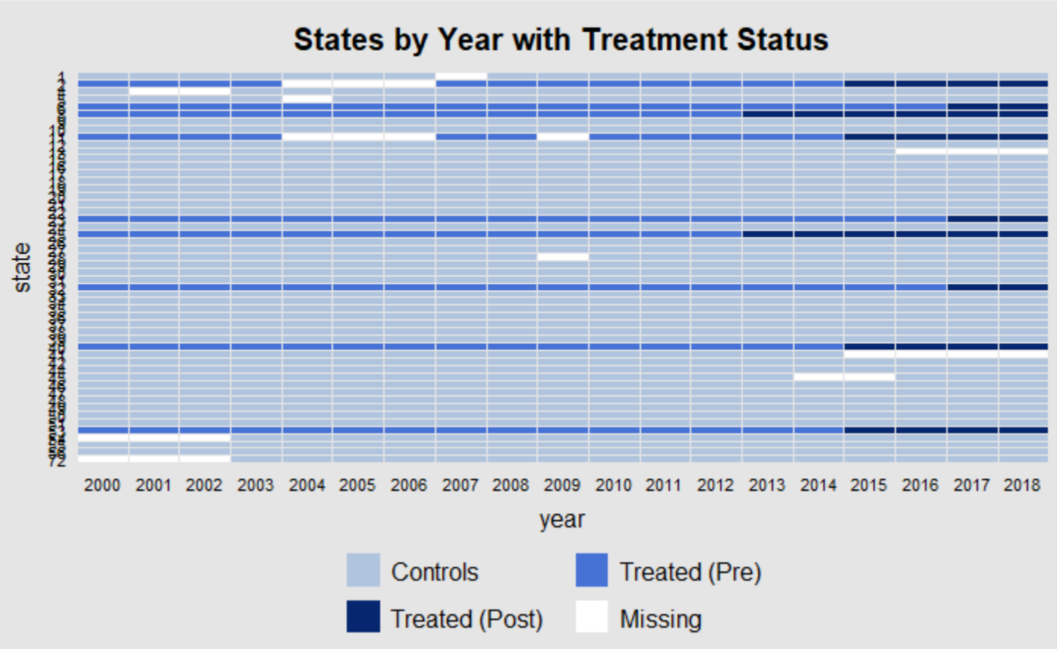
Data
Balance Table:
 | Mean Treatment | Mean Control | P-Value
Above-35 | .49 | .44 | 0
White | .64 | .7 | 0
Black | .16 | .17 | .73
Other Minority | .2 | .13 | 0
Advanced Degree | .2 | .23 | 0

Slide 4
Methodology
Synthetic Control
Uses a matching technique to take parts of states in the pre-period then weight them so that they look like the state you are studying and form a hypothetical counterfactual control state.
Assumes there is no new affect on the treated unit at the time of treatment that would affect the outcome other than treatment itself.
Stability-Controlled Quasi-Experiment
Looks like a Difference-in-differences but instead of assuming parallel trends you create a plausible range of changes in the outcome and see what it takes for the treatment to have no effect.
Assumes a plausible range of change in the outcome due to variation at the time of treatment that we cannot control for.

Slide 5
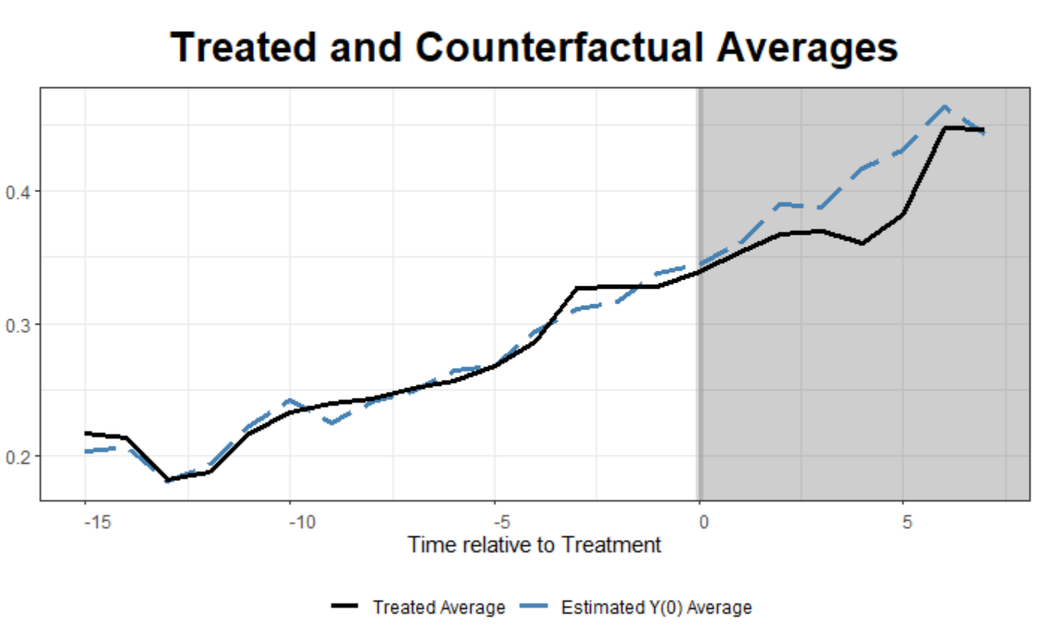
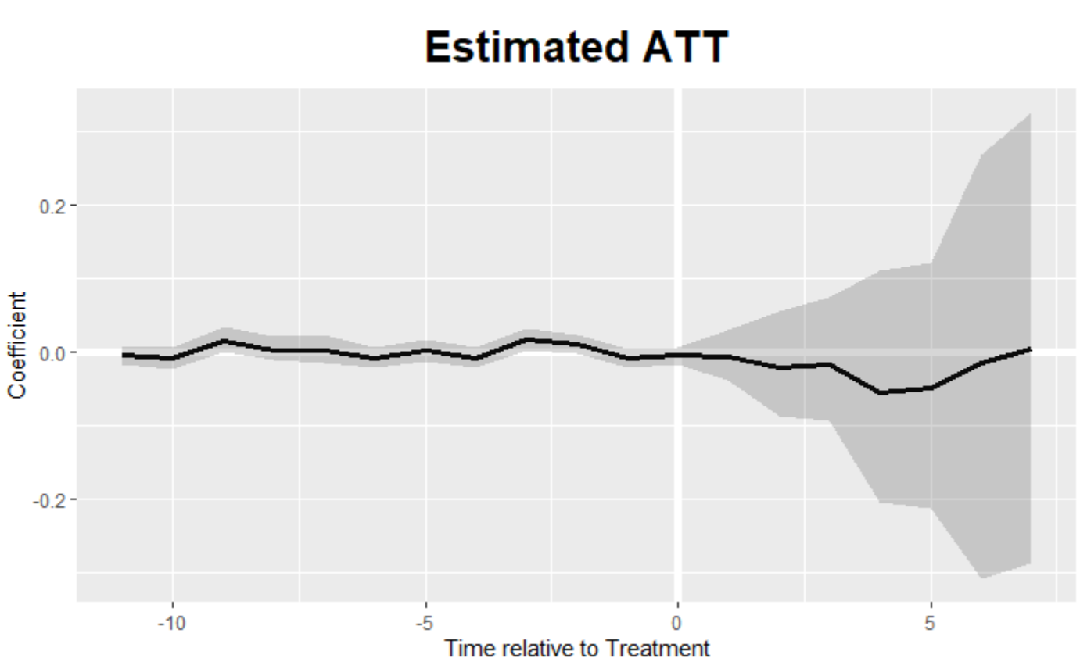
Synthetic Control

Slide 6
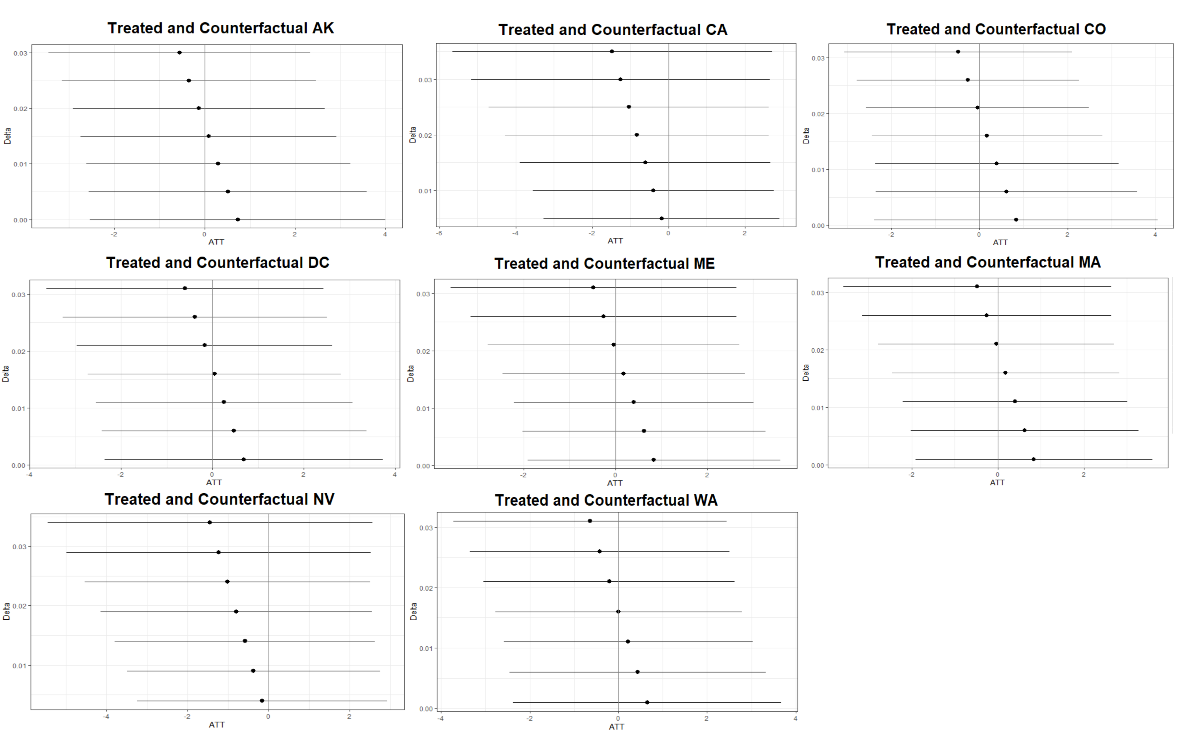
SCQE

Slide 7
Conclusions
Both designs gave similar results under different assumptions.
We find that there is no evidence of a significant effect in opioid admittance from marijuana policy.
The policy suggestion is that the opioid epidemic should not be considered when a state debates legalization.

Slide 8
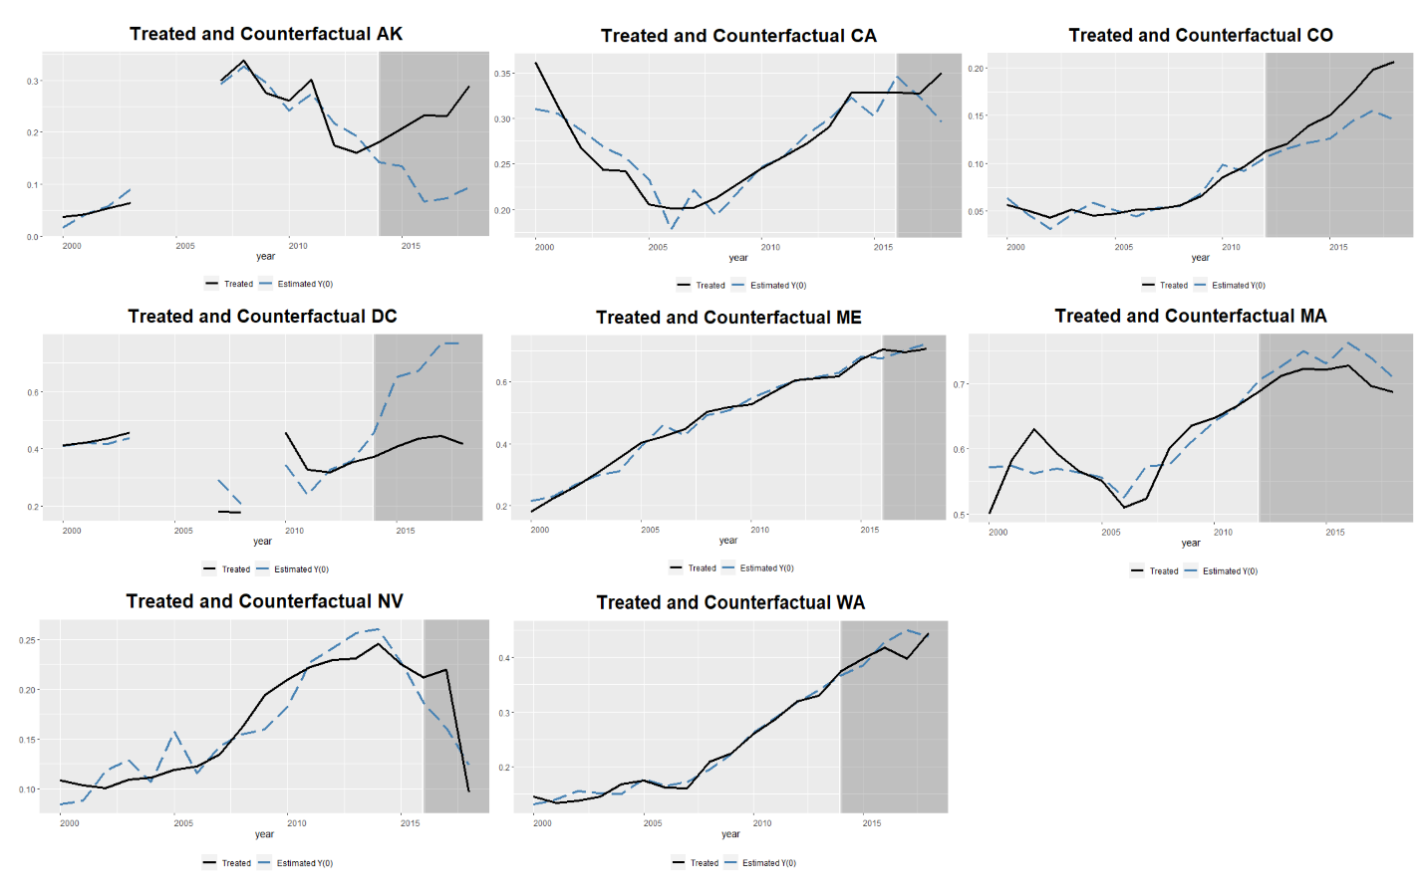
Other Plots and Materials

